Slide 1
Introduction to Linear/ Logistic Regression for Developing CPMs
Dr Glen Martin
glen.martin@manchester.ac.uk

Slide 2
Outline
This session aims to introduce you to some of the key statistical concepts underpinning logistic regression for the development of a clinical prediction model for binary outcomes.
Given the time constraints, we will not be able to cover all concepts in large detail. I will refer you to other sources, where relevant

Slide 3
The process of developing a CPM
A seven-step approach:
Consideration of the research question and initial data inspection
Coding of predictors
Model specification
Model estimation
Evaluation of model performance
Internal validation
Model presentation
This lecture is focussed on steps 3 and 4 of the seven steps for developing a CPM: in other words, the actual derivation of the model
Steyerberg, E., Vergouwe, Y. “Towards better clinical prediction models: seven steps for development and an ABCD for validation”. 2014. European Heart Journal

Slide 4
Linear Regression
Before we delve into logistic regression, lets begin with a simple case of a continuous outcome that we wish to model
A linear regression model is
Used to explore the (statistical) relationships between two or more variables and a continuous outcome of interest.
Useful for description, prediction or to improve our understanding of biological processes.

Slide 5
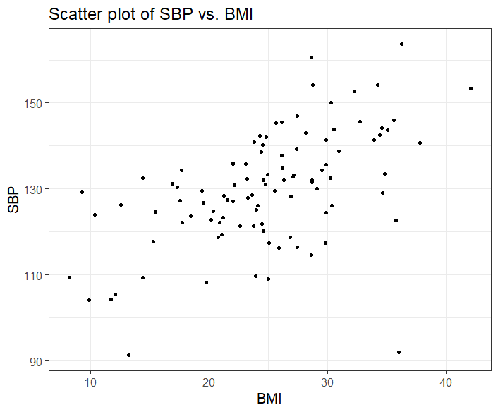
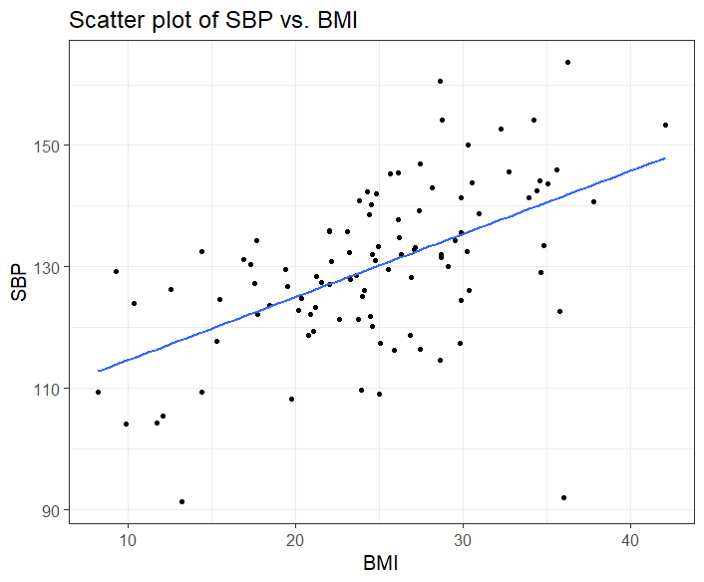
Linear Regression
Linear regression investigates how one (or more) variables affects another outcome of interest.
Notes:
Simple linear regression is essentially a ‘line of best fit’ through the scatter points

Slide 6
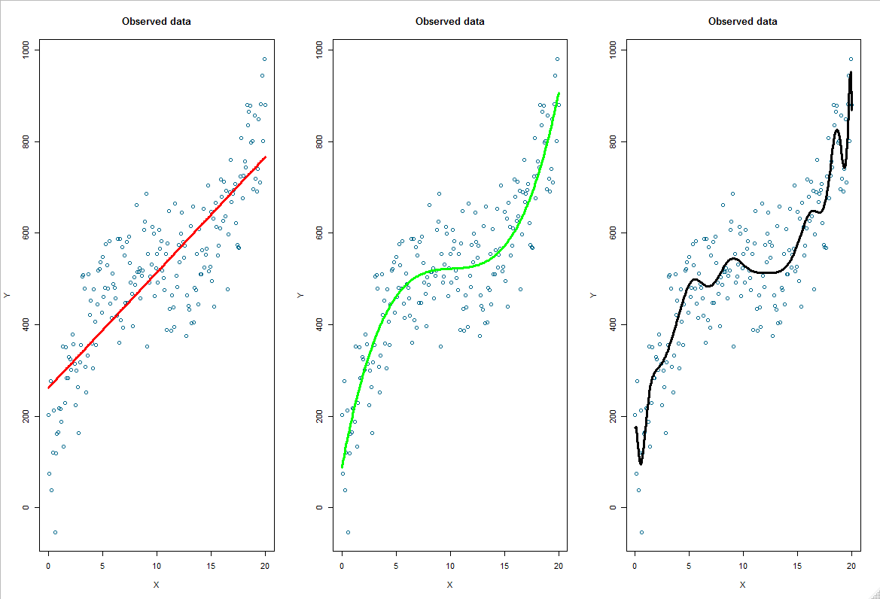
What about non-linear relationships?
Overfitting

Slide 7
What about non-continuous outcomes?
Frequently, outcomes are not continuous.
In this case, linear regression would not be appropriate.
Therefore, other modelling techniques are required:
Binary (yes/no) outcomes = logistic regression
Time-to-event outcomes = survival analysis (usually a Cox model)
We will cover logistic regression here, and time-to-event models later

Slide 8
Logistic Regression
In many cases, the response variable will be binary. For example:
The presence or absence of a disease
Mortality at 30-days post intervention
Logistic regression is an adaption to multiple linear regression that we use whenever the outcome is binary (e.g. represented by 0s and 1s, or TRUE and FALSE)

Slide 9
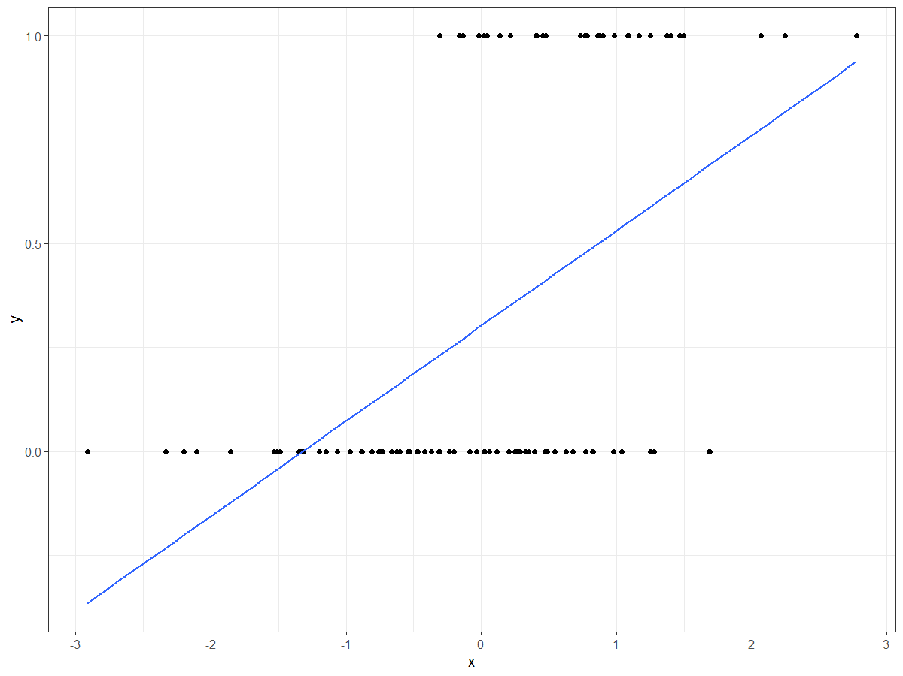
Linear regression does not work for binary outcomes
Fitting a linear regression to these data is clearly inappropriate

Slide 10

Logistic Regression
To circumvent this, logistic regression models the probability of the outcome occurring
$$p=Prob(Y=1)$$
Since $p$ can only take values between 0 and 1, logistic regression models the relationship between X and $p$through an ‘S-shape’ curve.

Slide 11
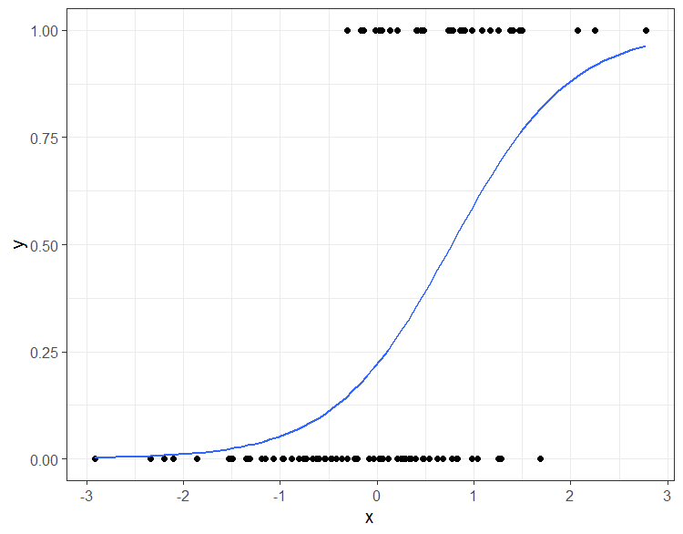
Logistic Regression
So, in other words, logistic regression can inform us how covariates associate with the probability of the outcome occurring

Slide 12
Interpretation of Logistic Regression
The model coefficients are then interpreted as odds ratios (ORs)
The OR is the ratio of the odds of event among those exposed over the odds of event among those not exposed
So, if:
OR < 1, then unit increases in X reduce the odds of Y occurring
OR>1, then unit increases in X increase the odds of Y occurring

Slide 13
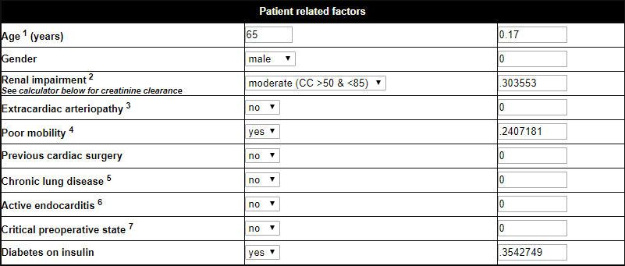

Using Logistic Regression for Prediction Modelling: EuroScore II example
…+several other variables

Slide 14
Take Home Messages
Logistic Regression models are a standard way of modelling binary outcomes
In terms of CPMs, the output from a logistic regression gives us the probability of the event occurring, given the inputted covariates/risk factors –
this is directly the quantity we are interested in when making predictions
The coefficients in the model have direct interpretations

Slide 15



Thank you
Glen Martin
Centre for Health Informatics
The University of Manchester, UK
glen.martin@manchester.ac.uk
@glen_martin1

